Slide 1
Analysis of Sales Data Sample
by Reham Essam

Slide 2
Table of contents
01
02
03
04
05
Data Cleaning
Power BI
SQL
Python
Insights

Slide 3
01
Data Cleaning
Using a (CSV) format suitable for further exploration
Steps:
Upload Data to CSV file
Transform data using Power Query
Remove unuseful columns
Remove Empty Rows
Change Data Type for Date and Time columns

Slide 4
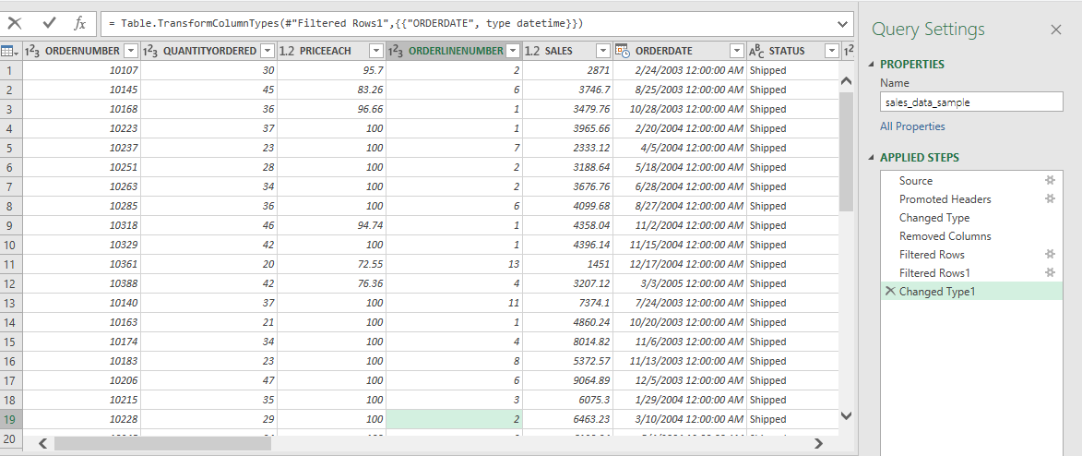

Slide 5
02
Power BI
Business Questions:
What is Total Sales per State?
What is Total Sales For each product Line?
What is The Quantity Of Orders?
What is the total Sales Per Country?
What is the total Sales Per City?
Which Status of Sales are shipped or canceled?
What is the total sales for line and orders number?
What is the average for order value each Year?
What is the Sales each Year , Quarter , Month, day?
what is total sales per customer for each Year , month and quarter?
what is Purchase Frequency Per Customer?
what is Purchase Frequency Per Customer per country?
What is the total Unique Customer?
what is customer segments per Year?
What is order numbers for DEALSIZE?
What is the total sales per product line per month?
What is MSRP per Product line?
what is total sales per customer for each city?
What is total sales for product line?

Slide 6
Steps:
Load the cleaned data from CSV.
Create Measures:
PurchaseFrequencyPerCustomer=COUNT('sales_data_sample'[ORDERNUMBER])
TotalSalesPerCustomer = SUM('sales_data_sample'[SALES])
TotalSalesPerProductLine = SUM('sales_data_sample'[SALES])
UniqueCustomers = DISTINCTCOUNT('sales_data_sample'[CUSTOMERNAME])
AverageOrderValue = DIVIDE(SUM(sales_data_sample[SALES]), COUNT(sales_data_sample[ORDERNUMBER]))
AverageSpendPerCustomer = AVERAGEX( VALUES('sales_data_sample'[CUSTOMERNAME]),[TotalSalesPerCustomer])
CustomerSegment = IF( [TotalSalesPerCustomer] > 1000,
"High-Value",
"Low-Value")
Data Visualization

Slide 7
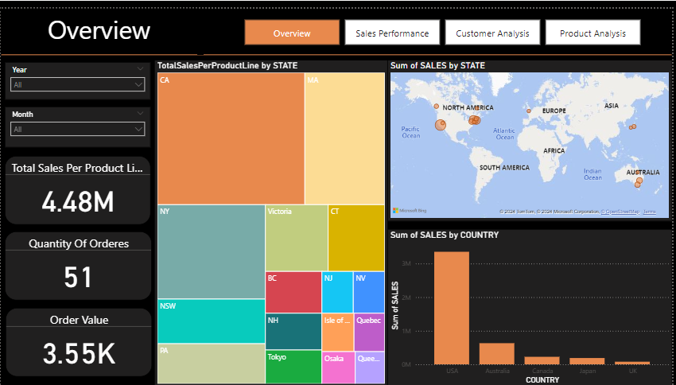

Slide 8
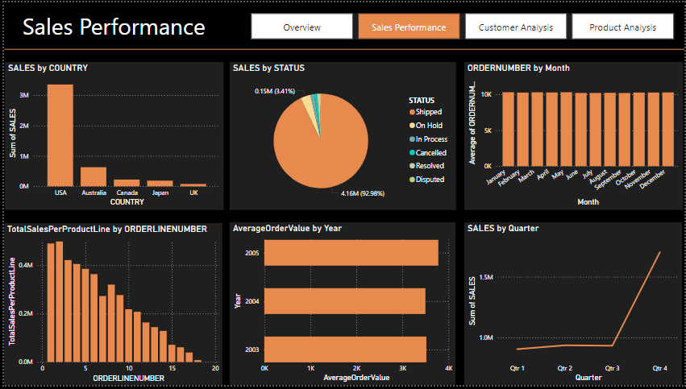

Slide 9
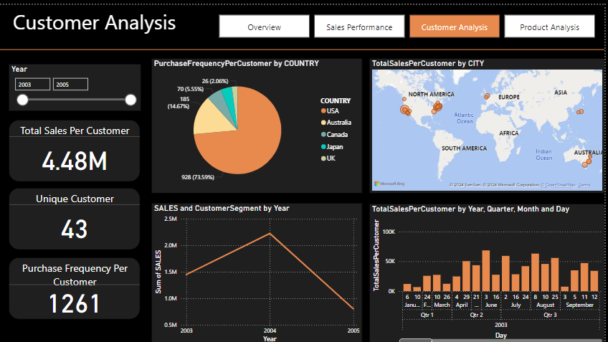

Slide 10
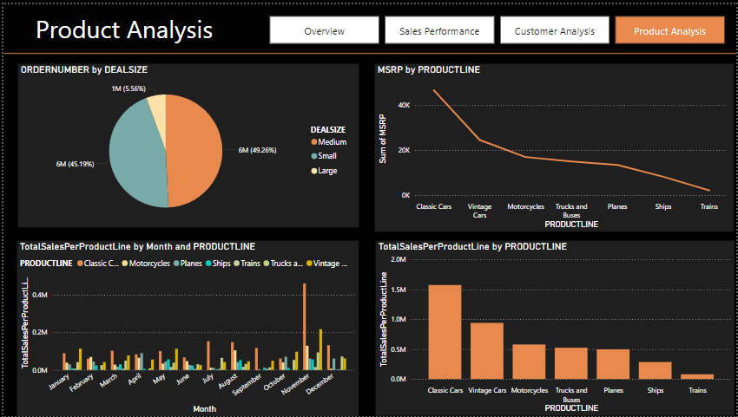

Slide 11
03
SQL
Import the E-Commerce Sales dataset file into https://sqliteonline.com
Write queries to:
Identify the total number of invoices, unique customers, and product categories.
Calculate basic summary statistics for key metrics like total sales amount, average order value, and most frequently purchased items.
Explore purchase patterns by country or any other relevant demographic information (if available).

Slide 12
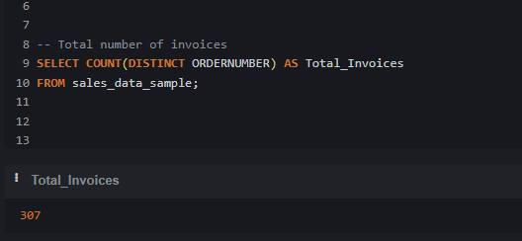
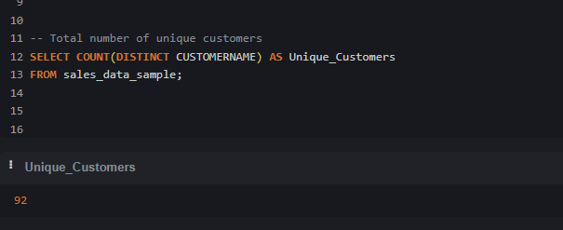
Total invoices ( I made this by count distinicit of ordernumber)
Unique Customer( I made this by count distinicit of customer name)

Slide 13
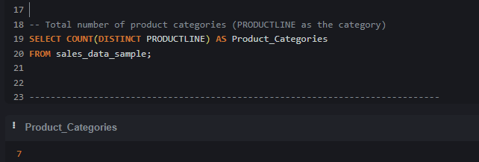
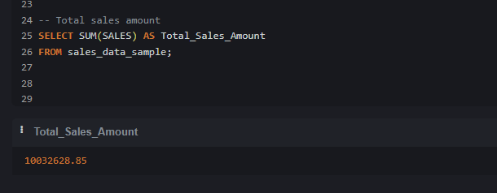
Total num of product category ( I made this by count distinicit of product line)
Total sales ( I made this by summation sales)

Slide 14
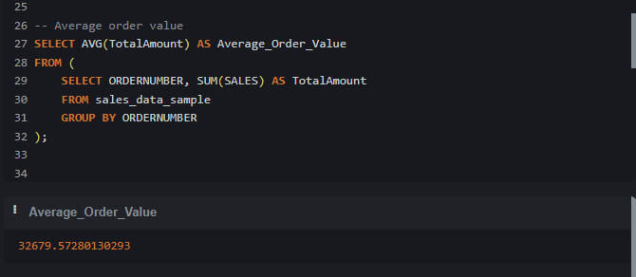
Average Order Value (Average = Ordernumber /sales )
First select ordernumber and summation of sales (sub query)
Use total amount from sub query and calculate average for it

Slide 15
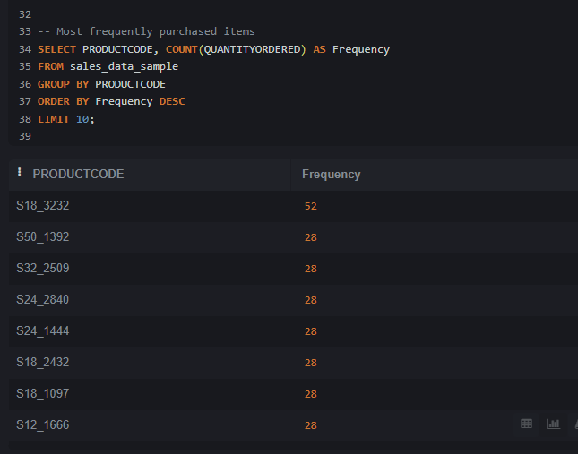
Most Frequently Purchased(select productcode and calculate count of Quantityordered )
Group by because aggregation function and limit 10 to get the most

Slide 16
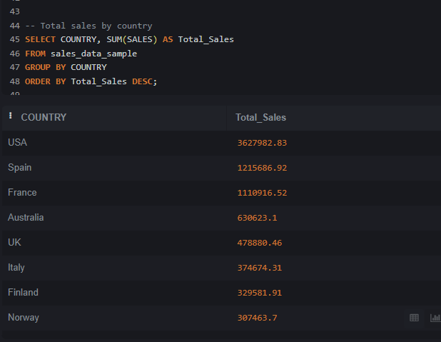
Total Sales(select country and calculate summation of sales )
Group by because aggregation function

Slide 17
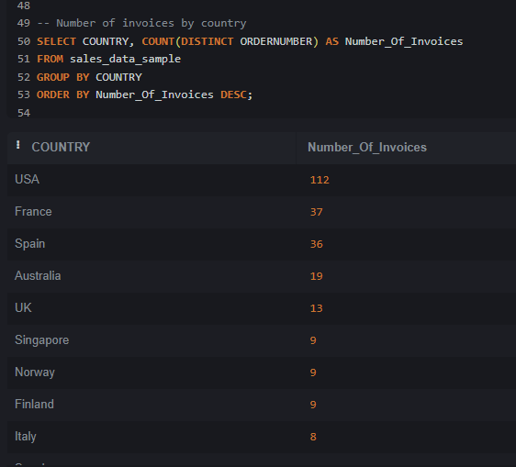
Total invoices by country ( I made this by count distinicit of ordernumber) and order by country

Slide 18
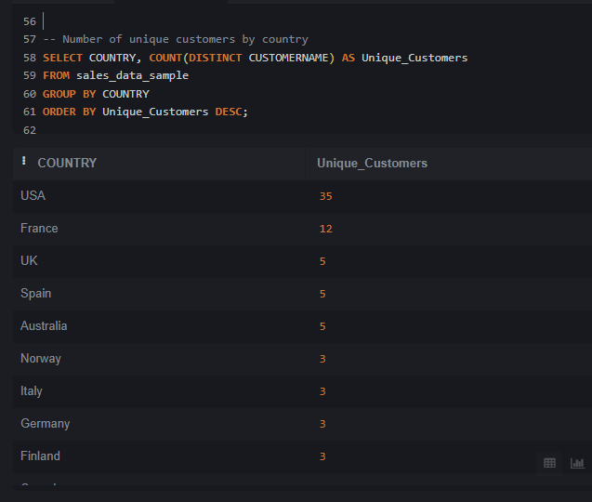
Unique Customer( I made this by count distinicit of customer name , country )
Order by country

Slide 19
04
Python
Import the E-Commerce Sales dataset
Cleaning Data
Analyze data
data visualization

Slide 20
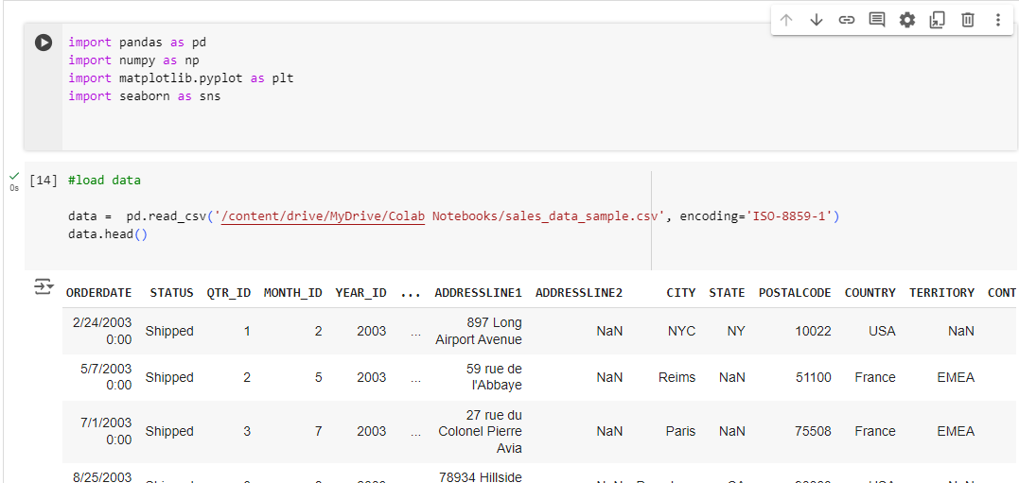

Slide 21
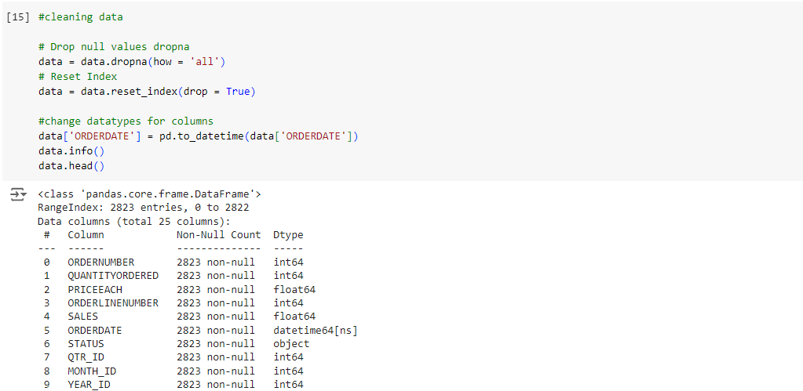

Slide 22
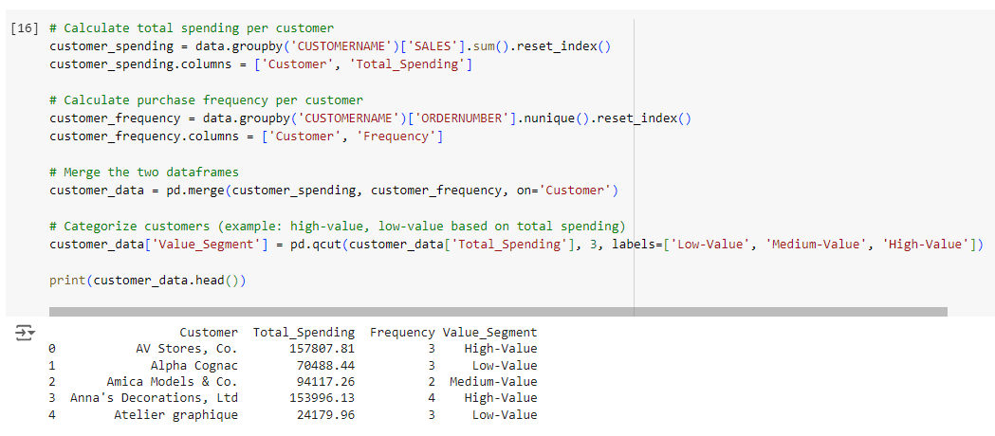

Slide 23
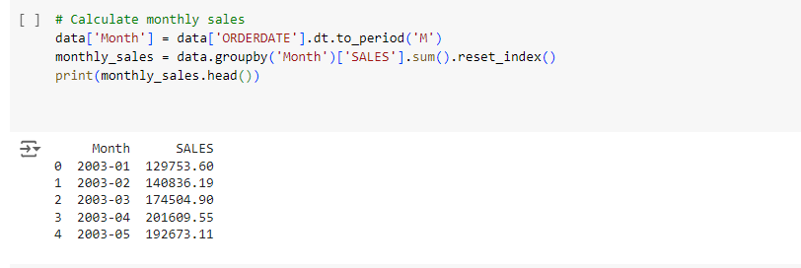

Slide 24
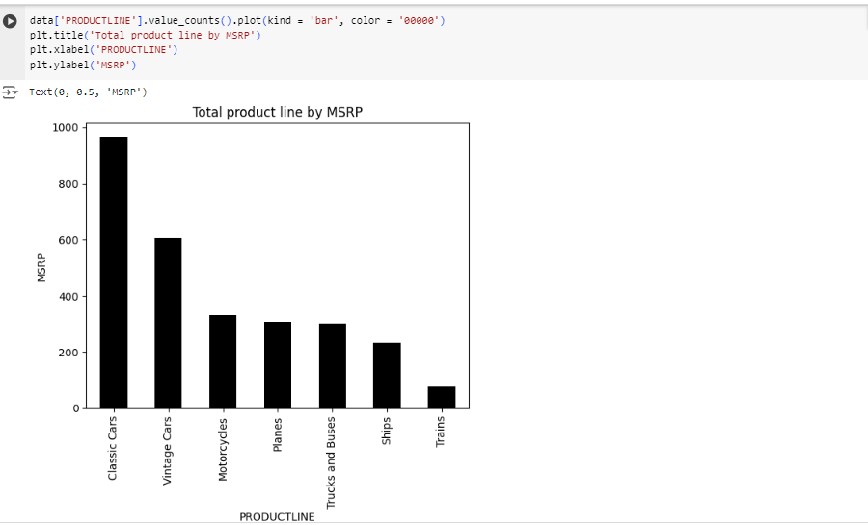

Slide 25
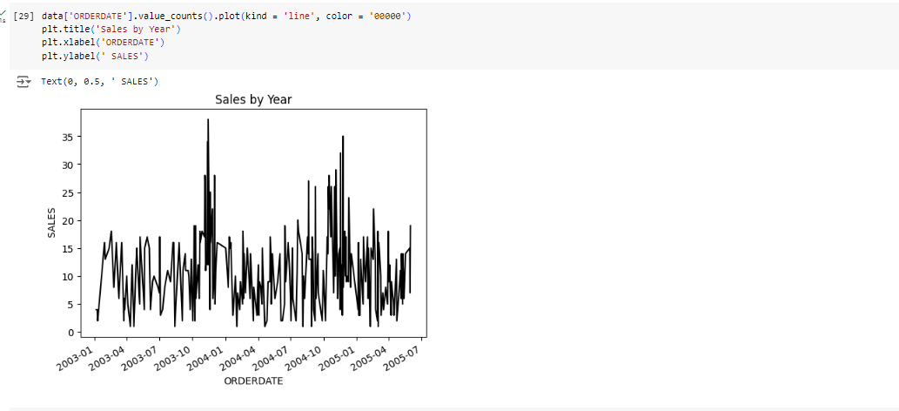

Slide 26
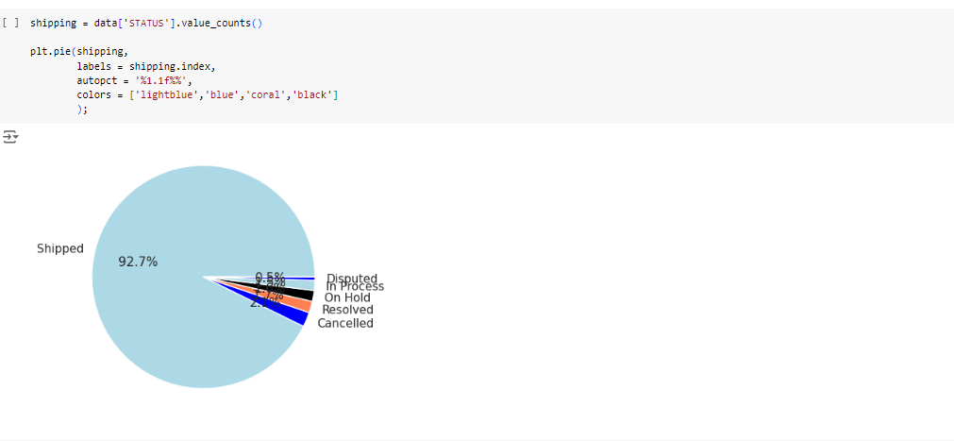

Slide 27
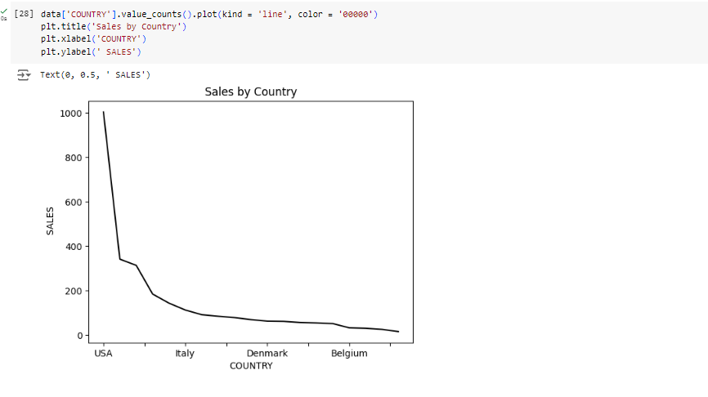

Slide 28
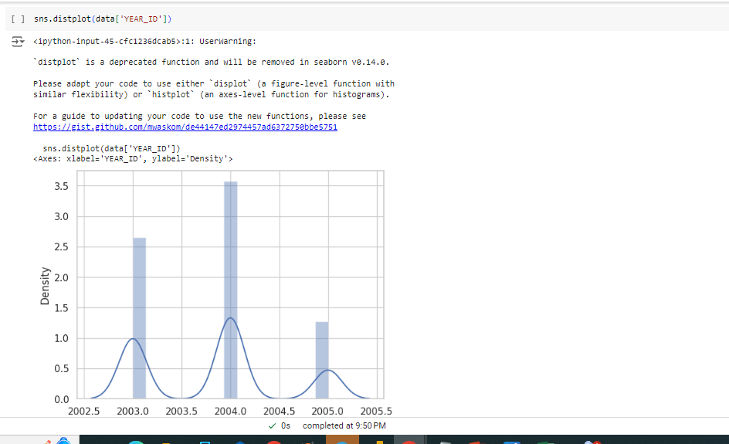

Slide 29
Insights
Total Sales Per Product Line is 4.48M.
USA is the highest sales Country. they used 3 M of Sales.
the most sales are shipped about 41.6 M.
Sales in 2004 is the highest sales and sales decreased in 2005.
total Unique Customer is 43.
Purchase Frequency Per Customer 1261
Customer segment sales in 2004 is the best.
Classic Car is the best seller in the product line
Deal size in medium and small is most ordered than large.
total sales in November 2005 for Classic Car is the bigger than other months.

Slide 30
Thanks!

